Slide 1
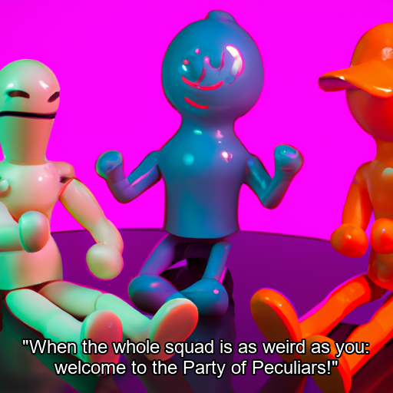
Meme Generator
Team Members
Name | Roll Number
Vaibhav Gupta | 20211CAI0118
Deepak | 20211CAI0193
Pavan S Reddy | 20211CAI0147
Chakradhar Reddy | 20211CAI0156

Slide 2
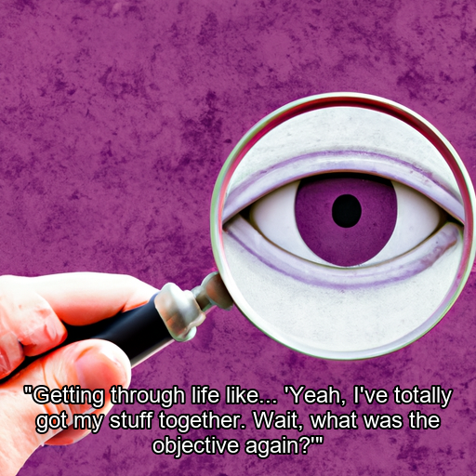
Objective
To design a meme generator that allows users to create humorous and engaging memes by leveraging AI-based image and text generation technologies.

Slide 3
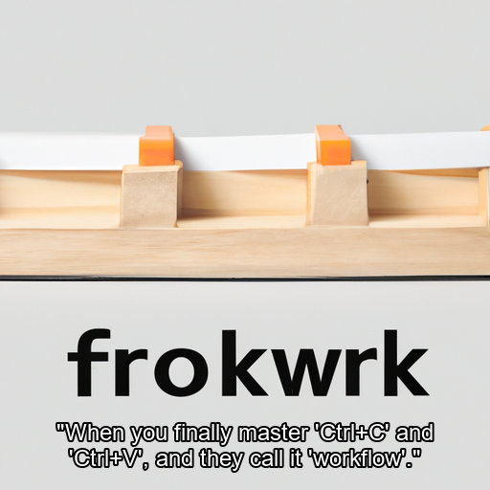
Workflow
Start
Text Input
Image Generation
Text Generation
Combining Text and Image
Output

Slide 4
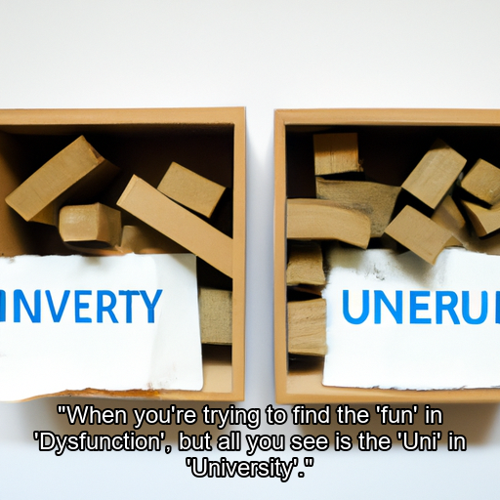
Conclusion
The project showcases the integration of creativity and technology, providing users with an easy-to-use platform for meme creation.

